Slide 1
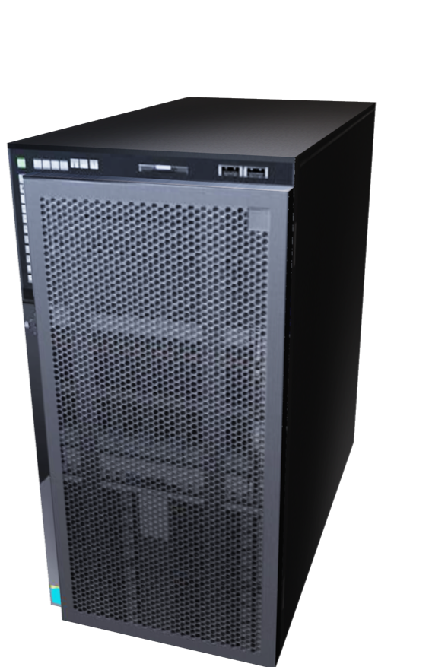

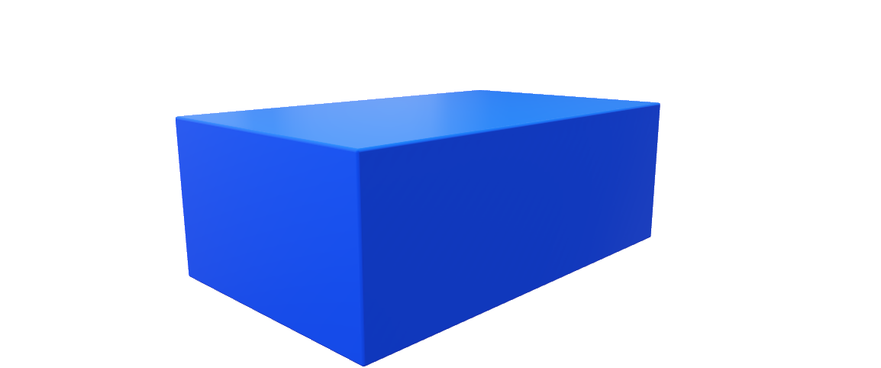
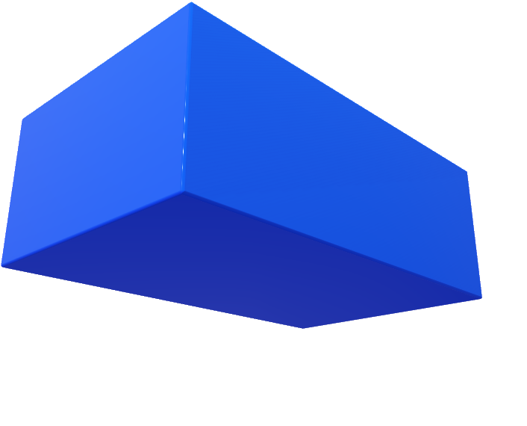
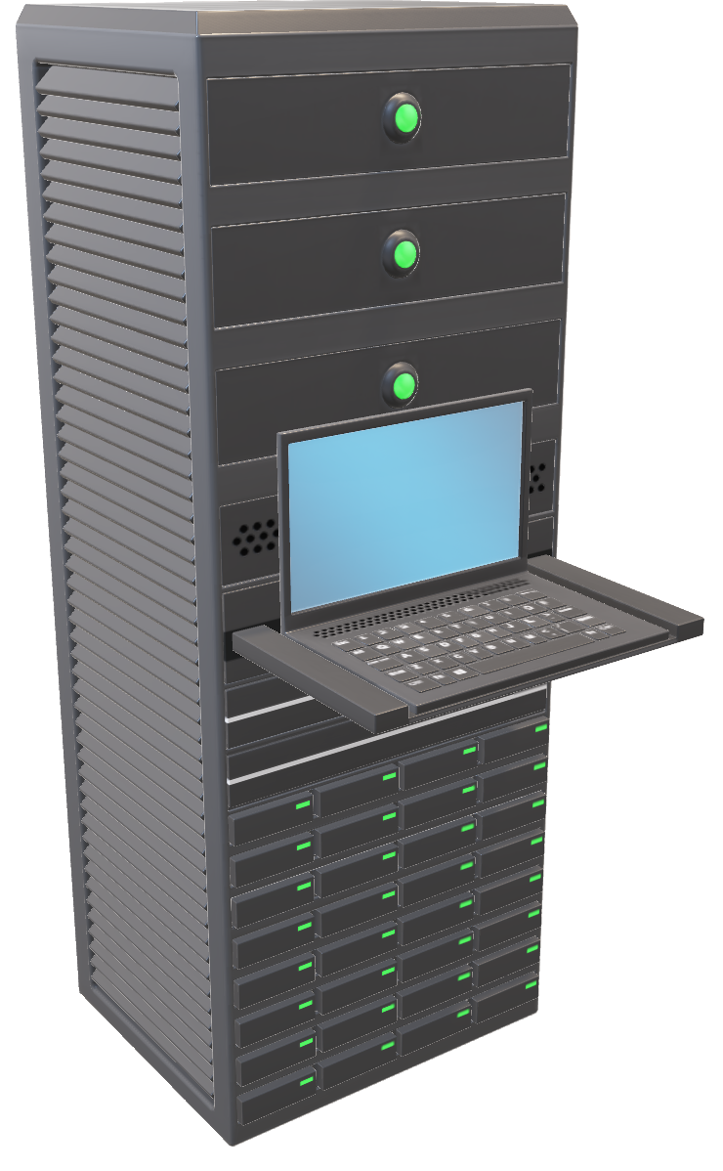
Research / Public Cloud Configuration
Public / Private Compute
S3 Storage
Public/Private Experiment Results
StudioML
Eco-system
Public/Private Experiment Metadata
Completion Service
Public Corpus

Slide 2
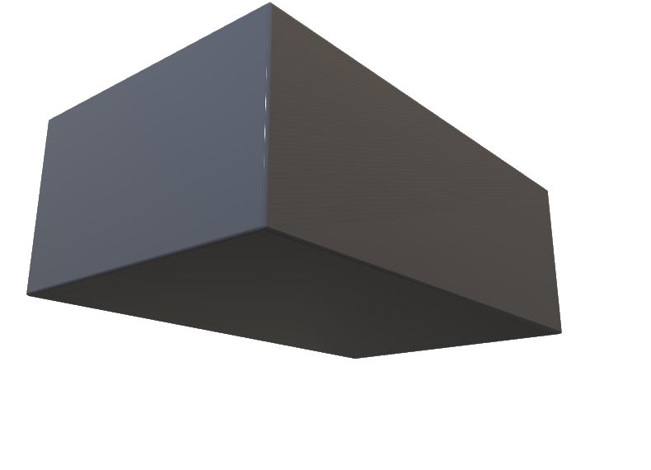

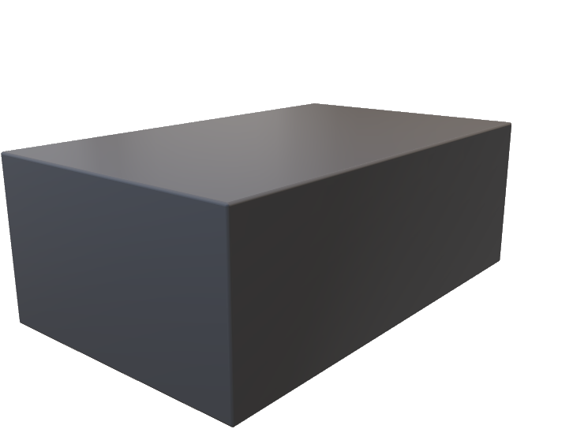
Cloud VPC Style Configuration
S3 Storage
Elastic (EKS Based) Compute
Private Corpus
Private Experiment Results
Completion Service
Private Experiment Metadata
Public Corpus
Private Corpus

Slide 3
Private Configuration
On Premise Kubernetes Compute
On Premise Minio S3 Storage
Private Corpus
Private Experiment Results
Private Experiment Metadata
Completion Service
Public Corpus
Private Corpus

